Slide 1
LESSON SIX
TOPICS: HOW TO BUILD A TARGET TO SHOOT.

Slide 2
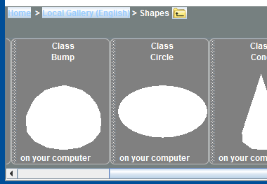
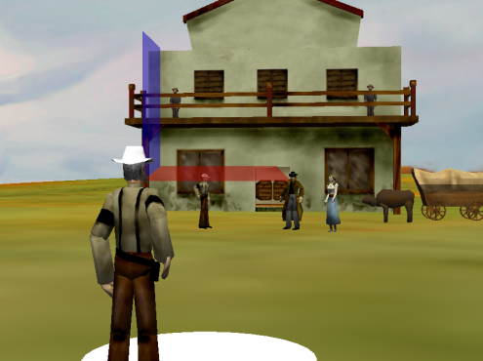
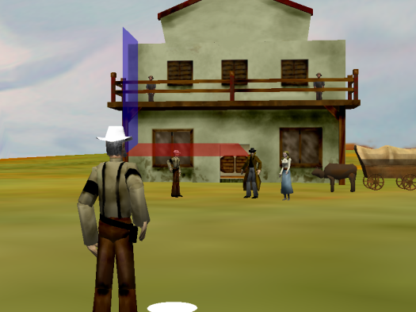
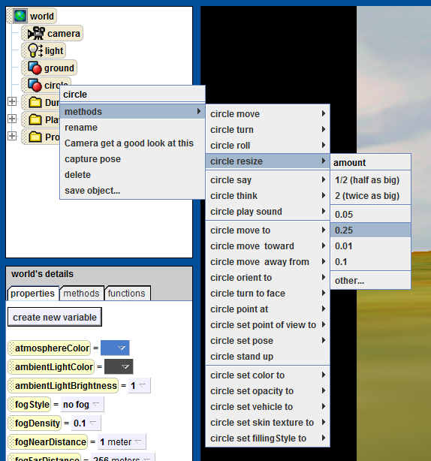
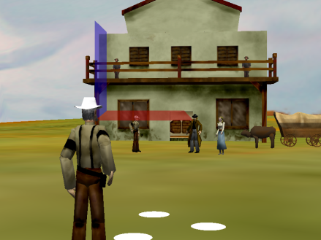
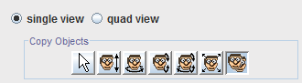
Step 1: Create the Circle for the Target
Add a Circle to your World.
Resize the circle to ¼ its current size.
Use the duplicate button to replicate the circle twice.
Notes:
Tell the students if they cannot see the first circle after step 1 then they find the circle in the object tree, and use its methods to move it forward into view.

Slide 3
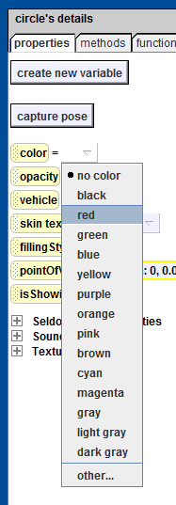
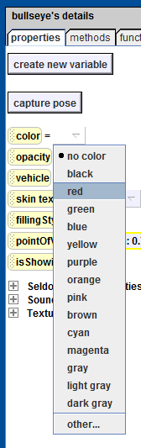

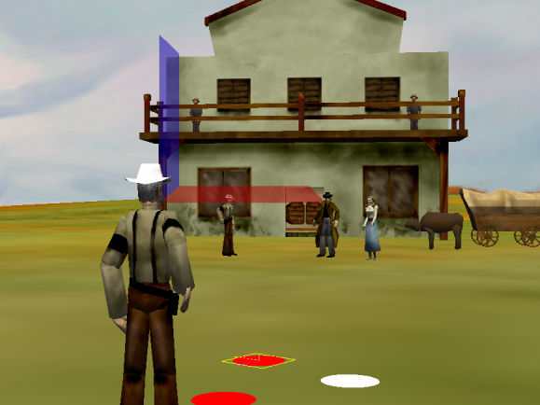
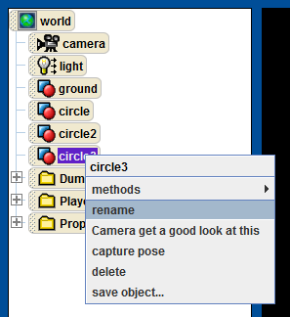
Step 2: Add Color to the Target
Rename circle3 to “bullseye”.
Change the color of circle to red.
Change the color of bullseye to red.

Slide 4
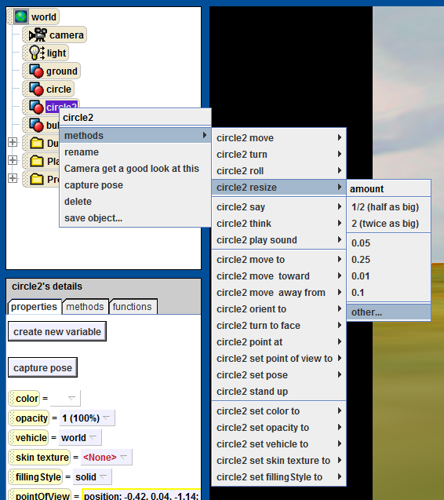

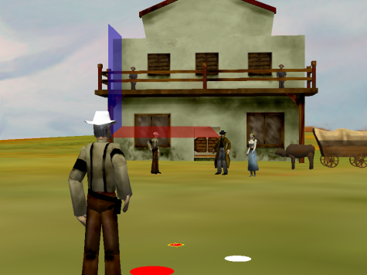
Step 3: Resize the Circles
Resize circle2 to 2/3 its current size.
Resize bullseye to 1/3 its current size.

Slide 5
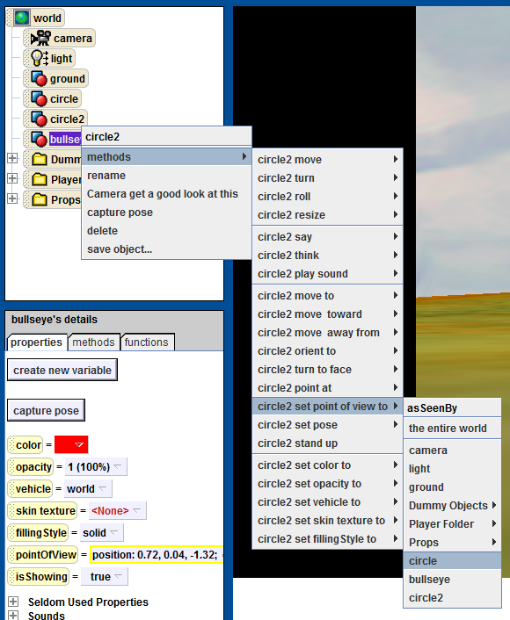

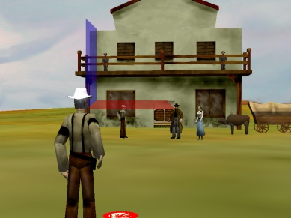
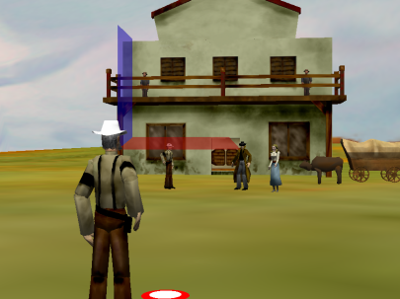
Step 4: Align the Target Circles
Set the point-of-view of circle2 and bullseye to that of circle.
Notice that Alice is not entirely sure how to render the circles because they exactly overlap each other.
Move circle2 up 0.01 meters.

Slide 6
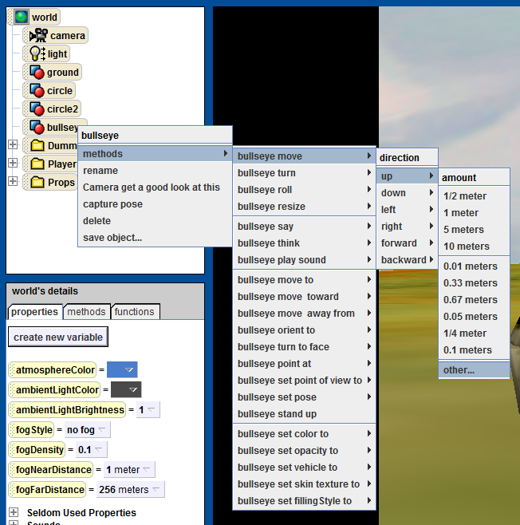

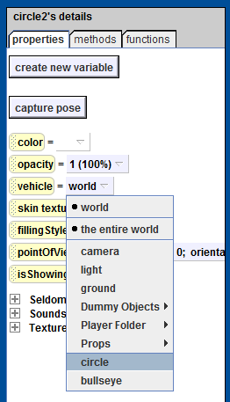

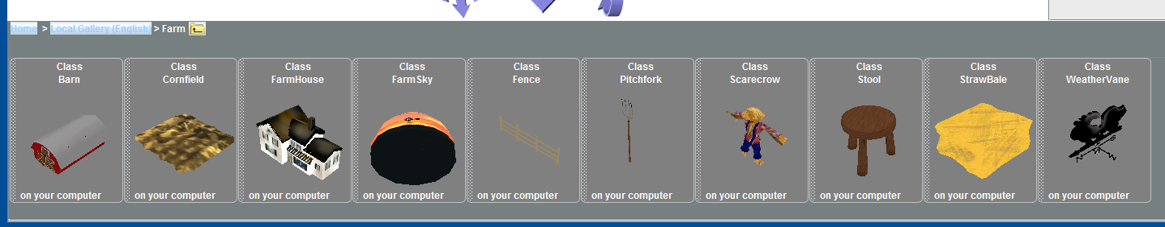
Step 5: Position the Target Circles
Move circle2 up 0.01 meters.
Set the vehicle of circle2 and bullseye to circle.
We need a stick for the target. To make a stick, add the “PitchFork” from the Farm library.

Slide 7
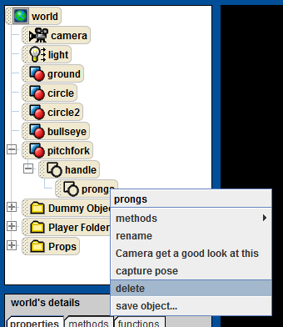
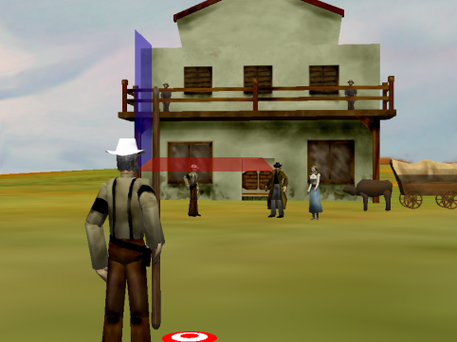
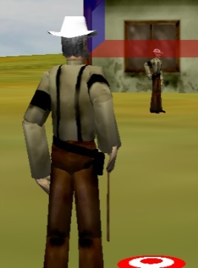
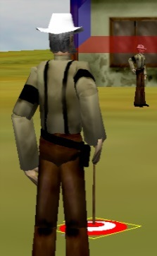
Step 6: Add a Handle to the Target
Delete the prongs from the pitchfork.
Rename the pitchfork “stick”.
Resize the stick to ¼ its current size.
Set the circle’s point-of-view to that of the stick.

Slide 8
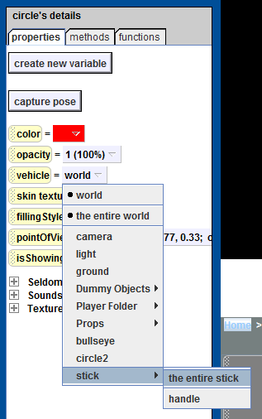
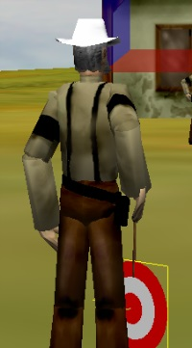
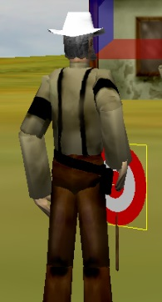
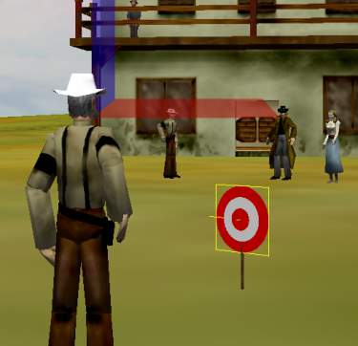
Step 7: Position the Target Handle
Rotate the circle forward ¼ revolution.
Move the circle backwards ½ meters.
Set the circle’s vehicle to stick.
Move the stick into view.

Slide 9
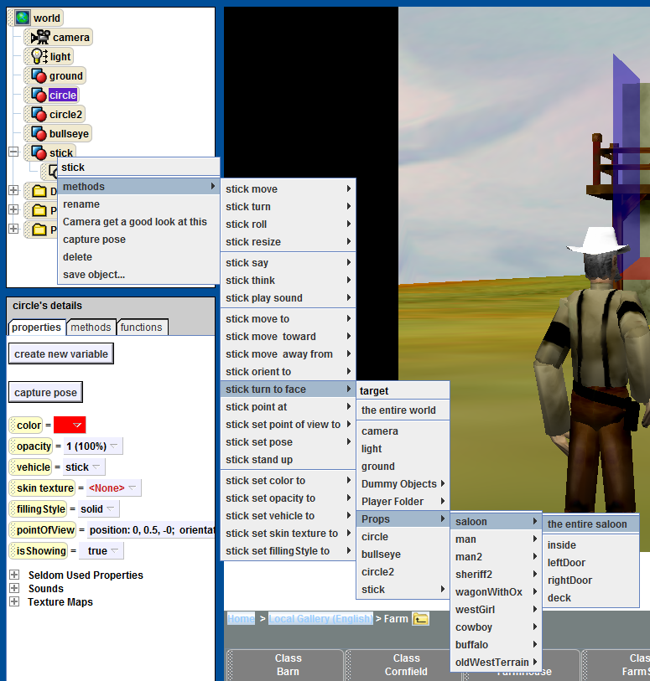
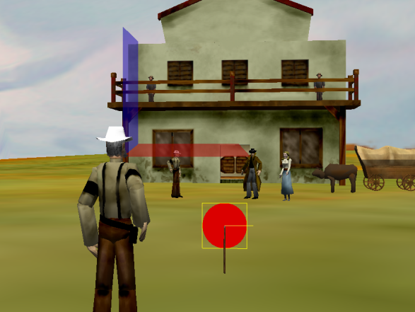
Step 8: Orient the Target
Programmatically, rotate the stick (Target) so that its forward direction is pointing toward the saloon. Do this by selecting “turn-to-face entire saloon.” This will align the Target’s axis with that of the Player View and IntroPos.

Slide 10
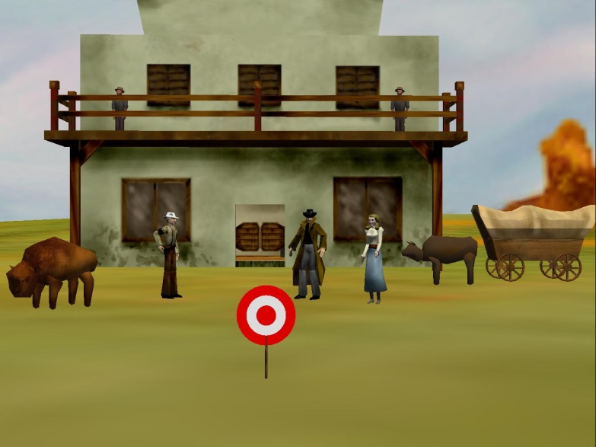
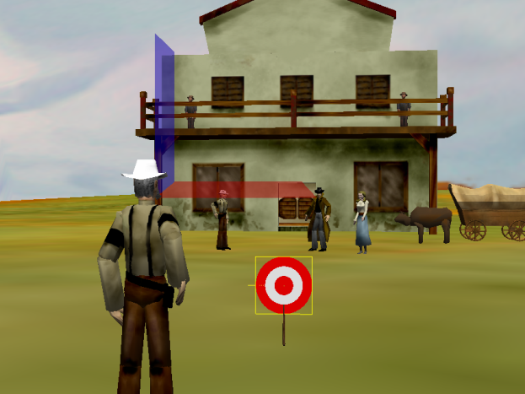
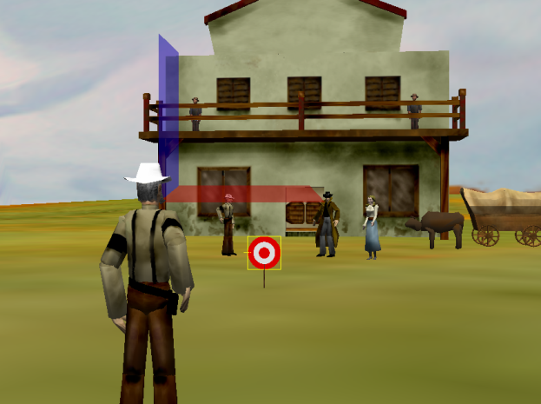
Step 9: Finish Things Up
Turn the stick ½ revolution to look at the player.
Play your world. If the Target is not in view then move it farther back in the Alice scene. The final scene should have the Target visible from the Player View position.
Create a new folder called “Target”, and add the circle, circle2, bullseye, and stick to it.

Slide 11
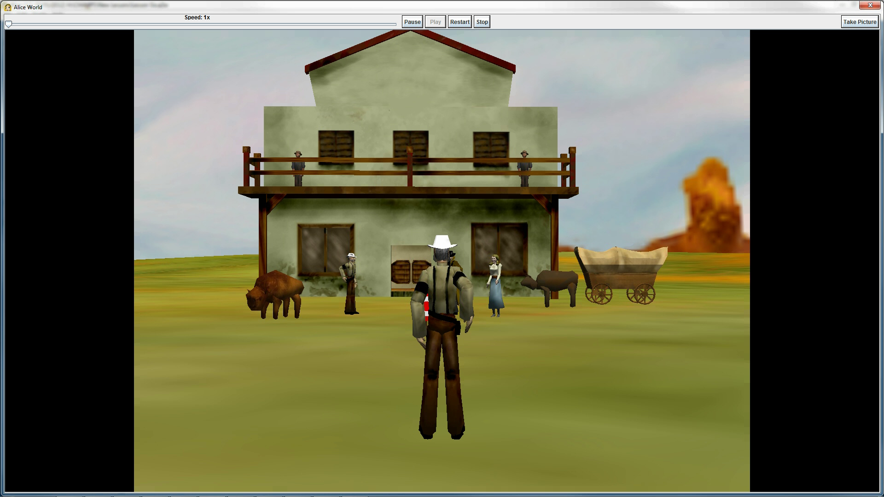
Final Scene

